Slide 1
Operating Systems
Chapter 2 (a)
Operating System Structures
Hammad Afzal (PhD)
hammad.afzal@mcs.edu.pk
Department of Computer Software Engineering
National University of Sciences and Technology

Slide 2
Chapter 2: Roadmap
Operating System Services
User Operating System Interface

Slide 3
Operating System Services
OS provide an environment for execution of programs and services to programs and users of these programs.
One set of operating-system services provides functions that are helpful to the user and programmer:
Some of the functions provided by OS services are:
User interface
Program execution
I/O operations
File-system manipulation
Communications
Error Detections

Slide 4
Operating System Services
User interface –
Almost all operating systems have a user interface (UI).
Varies between Command-Line (CLI), Graphics User Interface (GUI), Batch
CLI: Mechanism to enter text commands and edit those commands
Batch Interface: Commands and directives to control those commands are entered into files.
GUI: Window system with pointing device to direct I/O, choose from menus etc.

Slide 5
Operating System Services
Program execution –
The system must be able to load a program into memory and
To run that program, end execution, either normally or abnormally (indicating error)

Slide 6
Operating System Services
I/O operations
A running program may require I/O, which may involve a file or an I/O device.
OS must provide way to deal with it.
File-system manipulation
Programs need to read and write files and directories, create and delete them, search them, list file Information, permission management.

Slide 7
Operating System Services (Cont.)
Communications
Processes may exchange information, on the same computer or between computers over a network
Communications may be via shared memory or through message passing (packets moved by the OS)

Slide 8
Operating System Services (Cont.)
Error detection
OS needs to be constantly aware of possible errors
Errors may occur in the
CPU and memory hardware (memory error or power failure),
In I/O devices (a parity error on tape, connection failure on network, lack of paper in printer),
In user program ( an arithmetic overflow, attempt to access illegal memory location)
For each type of error, OS should take the appropriate action to ensure correct and consistent computing.

Slide 9
Operating System Services
OS functions for ensuring the efficient operation of the system itself via resource sharing
Resource allocation - When multiple users or multiple jobs running concurrently, resources must be allocated to each of them
Many types of resources - Some (such as CPU cycles, main memory, and file storage) may have special allocation code, others (such as I/O devices) may have general request and release code
Example, OS have CPU scheduling routines that take into account speed of CPU, jobs that must be executed, number of registers available, and other factors.

Slide 10
Operating System Services
Accounting –
To keep track of which users use how much and what kinds of computer resources.
Protection and security
Concurrent processes should not interfere with each other
Protection involves ensuring that all access to system resources is controlled
Security of the system from outsiders requires user authentication (by means of password), extends to defending external I/O devices from invalid access attempts

Slide 11
User Operating System Interface
Two approaches for users to interface with OS: Command-line and Graphical User.
Command Line Interface (CLI) or command interpreter allows direct command entry
Sometimes implemented in kernel,
Others (Windows, Xp) treat command interpreter as a special program that is running when user first logs on.

Slide 12
Command Line Interface (CLI)
Sometimes multiple flavors implemented – shells
(E.g. Bourne shell, C shell, Bourne-Again shell, Korn shell in Unix and Linux)
Main function of command interpreter is to get and execute the next user-specified command.
Mostly manipulate files (copy, delete, edit, list etc)

Slide 13
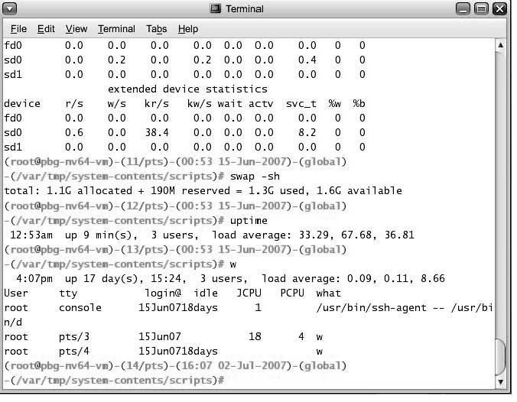
Bourne Shell Command Interpreter

Slide 14
Command Line Interface (CLI)
Two approaches to implement commands.
Command interpreter itself contains code to execute command.
Number of commands determine size of command interpreter since each command has its own code.
Implement commands through system programs (in UNIX)
Command interpreter does not understand the command.
It only identifies the file to be loaded in memory and execute
E.g. rm file.txt: The code to implement rm command will be in file rm.

Slide 15
Graphical User Interface (GUI)
User-friendly interface (desktop)
Usually mouse, keyboard, and monitor
Icons represent files, programs, actions, etc
Various mouse buttons over objects in the interface cause various actions (provide information, options, execute function, open directory (known as a folder)
Invented at Xerox PARC (1970s)
Became more common by Apple Macintosh (in 1980s)

Slide 16
Graphical User Interface (GUI)
Many systems now include both CLI and GUI interfaces
Microsoft Windows is GUI with CLI “command prompt MS DOS” shell
Apple Mac OS X as “Aqua” GUI interface with UNIX kernel underneath and shells available
Solaris is CLI with optional GUI interfaces (Java Desktop, KDE)

Slide 17
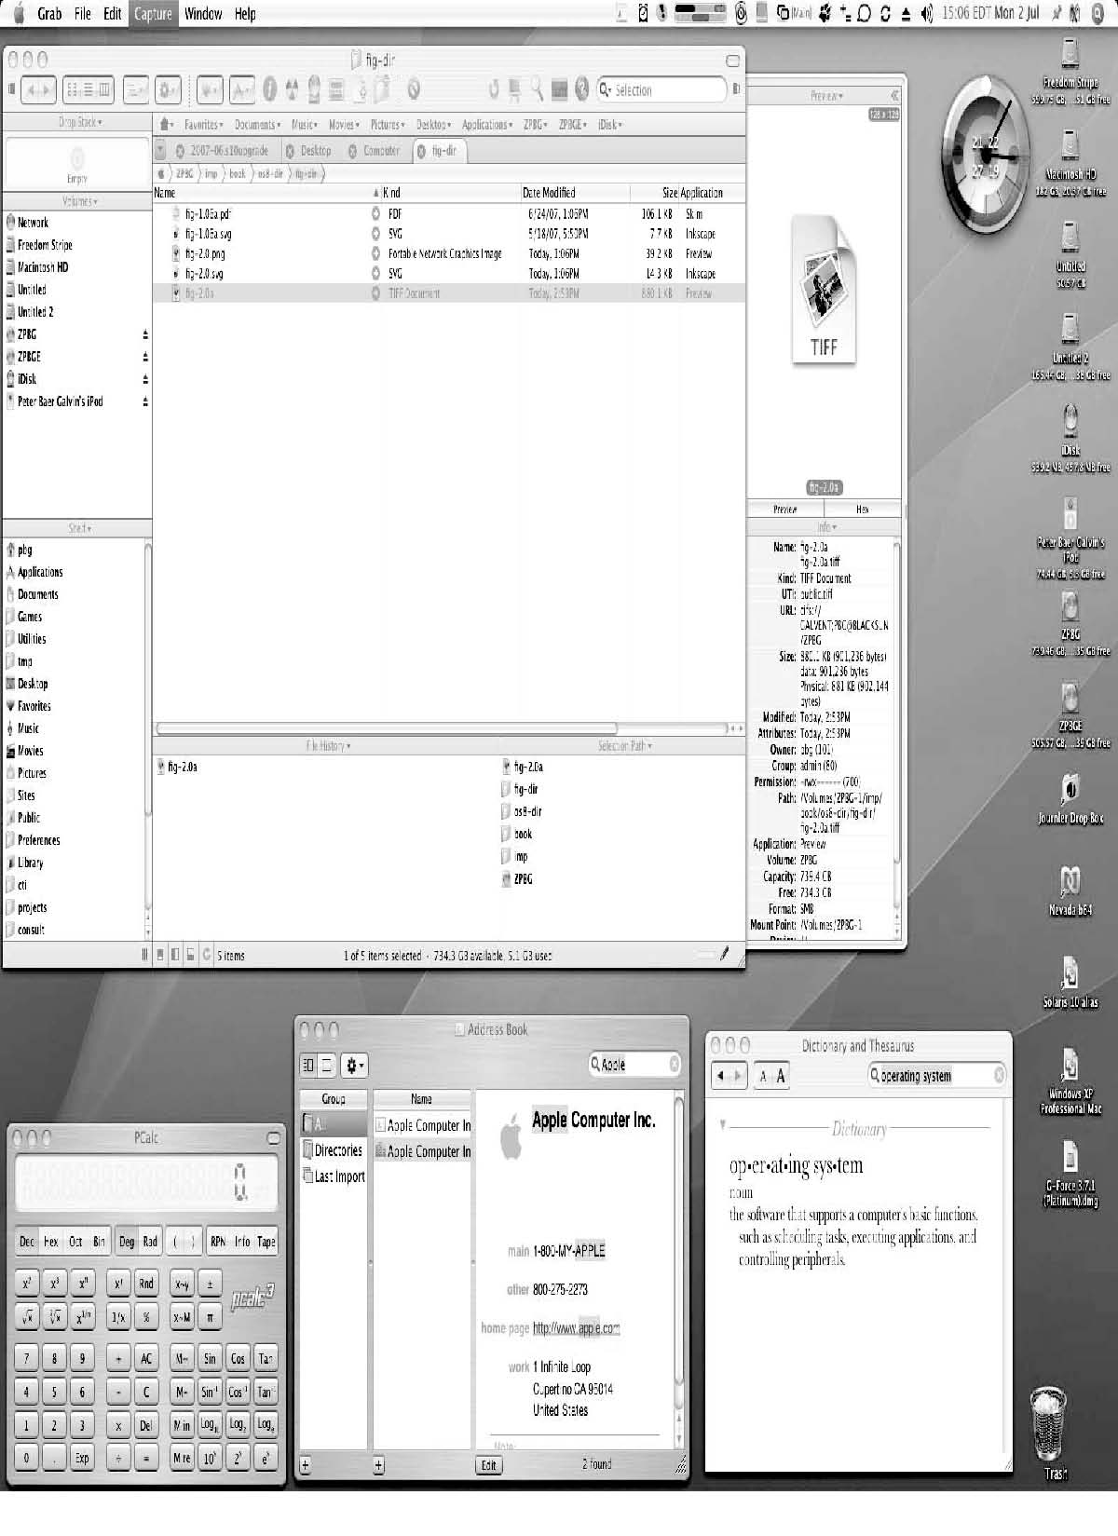
The Mac OS X GUI

Slide 18
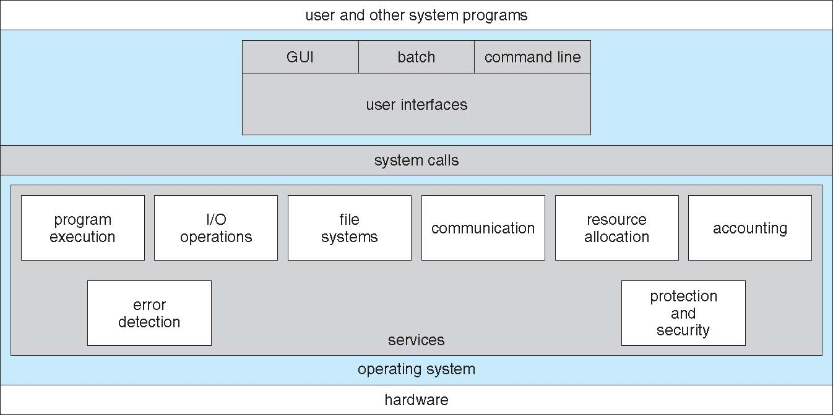
View of Operating System Services

